Slide 1
Hot S22 Measurements

Slide 2
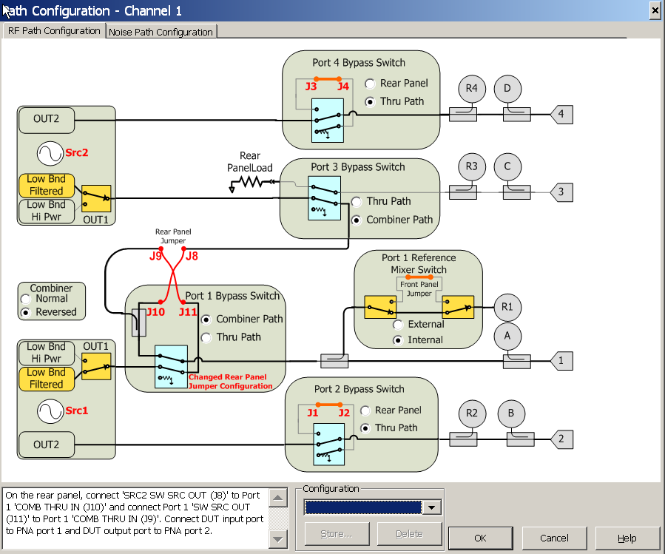
Hot S22 Measurements
Measurement Block Diagram
Use the “Hot S-Parameters”
pre-stored configuration

Slide 3
Hot S22 Channel Setup & Calibration
Setup the channel for the S-Parameter frequencies that you want to measure.
change to step sweep.
Select the “Hot S-Parameters” pre-stored configuration and re-wire the back panel jumpers as shown on the diagram. This is done to assure that the Hot signal coming from source 2 has enough power to drive the amplifier. Since the S-Parameter signal does not have to be very high power, source 1 is re-routed through the coupled arm of the combiner.
In the FOM dialog turn on FOM and set the source 2 frequencies with a positive or a negative offset of at least (IFBW X 100). This will be the frequency of the Hot signal and needs to be far enough away from the measurement frequencies to avoid interference.
In the Power & Attenuator dialog make port 2 attenuators manual and put at least 10 dB of attenuation on the source path and appropriate attenuation on the B receiver taking into account the gain of the amp and the input level of the hot signal. Make sure “Port 1 Src2” and “Port 3” are both set to Off.
Perform a 2-port S-Parameter cal in this channel.
Connect the DUT and measure S22.
In the Power & Attenuator dialog turn on “Port 1 Src2” and set its power to the appropriate drive level. Notice the change in S22.
To ensure that the amp is being driven at the desired power level, you can perform a source power cal for “Port 1 Src2”.

Slide 4
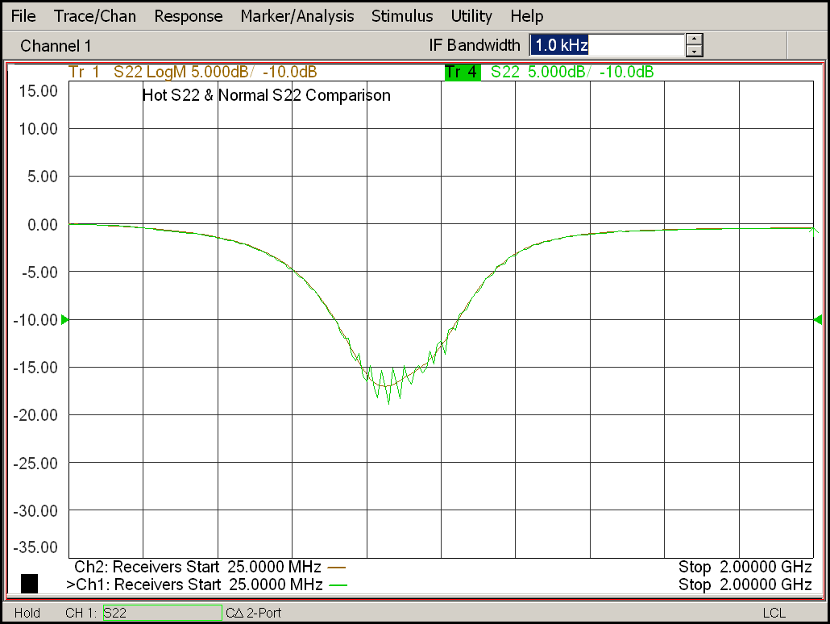
Hot S22 Measurement Result
DUT = Hittite HMC452ST89 Power Amplifier tuned for 900 MHz Comparison
Hot Signal ON
Hot Signal OFF
Note:
If the Hot signal is too close to the measurement signal, ripples will appear on the out of band regions of the amplifier response.

